Slide 1



SOMNIFEROUS DRIVING RECOGNITION SYSTEM
B.TECH MAJOR PROJECT EP-402

Slide 2
SOMNIFEROUS DRIVING RECOGNITION SYSTEM
Under the Supervision of
Mentor
Prof. Srinivas Rao Allam Sir
Co-ordinator
Dr. Amrish K. Panwar Sir

Slide 3
SOMNIFEROUS DRIVING RECOGNITION SYSTEM
SUBMITTED BY:
AMIT SETH AYUSH KISHORE VINAY YADAV
2K18/EP/012 2K18/EP/019 2K18/EP/090

Slide 4

01
INTRODUCTION
03
TECHNIQUES FOR DETECTIONG SOMNIFEROUS STATE
02
OBJECTIVE
04
LOCALIZATION OF FACE

Slide 5
05
LOCALIZATION & TRACKING THE EYES
07
DETECTION OF SOMNIFEROUS
06
PRACTICAL SET UP
08
OUTCOMES

Slide 6
09
VOLVO’S DRIVER ALERT SYSTEM
11
FUTURE SCOPES & CONSEQUENCES
10
BIBLIOGRAPHY & REFERENCES
12
IMAGE OF THE PROJECT
13
SOURCE CODE OF THE PROJECT

Slide 7
INTRODUCTION
01

Slide 8

The National Transportation Safety Board(NTSB) in the United States have indicated the significant danger of fatigued drivers operating heavy vehicles. 52% of heavy truck single vehicle accidents were fatigue-related. Annually, it is estimated there are 40,000 injuries and 1,550 fatalities caused from fatigued persons at the wheel.
Also based on researches done by the Real Automóvil Club de España (RACE), driver SOMNIFEROUS involves a high percentage (30%) of traffic accidents.
Also a research suggests that up to 25% of accidents
on monotonous roads in India are fatigue related.

Slide 9
OBJECTIVE
02

Slide 10
The objective is to overcome the problem related to the accidents related to drivers experiencing fatigue leads to a need arises to design a system that keeps the driver focused on the road.
Therefore many designs and prototypes have been implemented in automobiles to avoid such accidents by keeping the whole focus and concentration on accurately monitoring the open and closed state of the driver’s eye in real time.

Slide 11
03
LIBRARIES USED IN PROJECT

Slide 12
The libraries that we have used to prepare the whole mode is
Scipy
Imutils
Threading
Playsound
Numpy
OpenCv
Dlib
Keras
Tensorflow
time

Slide 13
04
TECHNIQUES FOR DETECTION SOMNIFEROUS STATE

Slide 14
The proposed method is built in four stages and it is applied to the colored images with any background:
Localization of Face
Localization of the Eyes
Tracking the eyes in the subsequent frames
Detection of Somniferousness.

Slide 15
LOCALISATION OF FACE
05

Slide 16
Since the Face is symmetric, a symmetry-based approach. It was found that it is enough to use a sub sampled, gray-scale version of the image. A symmetry-value is then computed for every pixel- column in the reduced image.
If the image is represented as I(x, y) then the symmetry value for a pixel-column is given by :
S(x) = ∑∑ [abs I ((x,y-w)-(x,y+w))].
S(x) is computed for X € [k,size-k] where k is the maximum distance from the pixel-column that symmetry is measured, and x size is the width of the image. The x corresponding to the lowest value of S(x) is the center of the face.

Slide 17
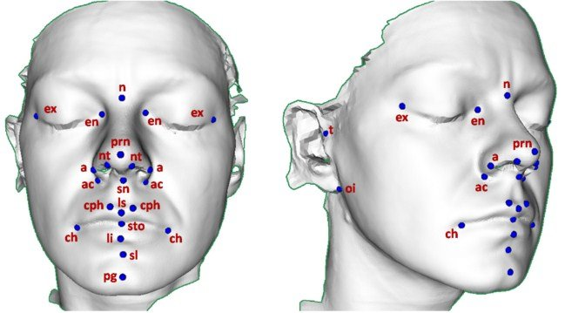
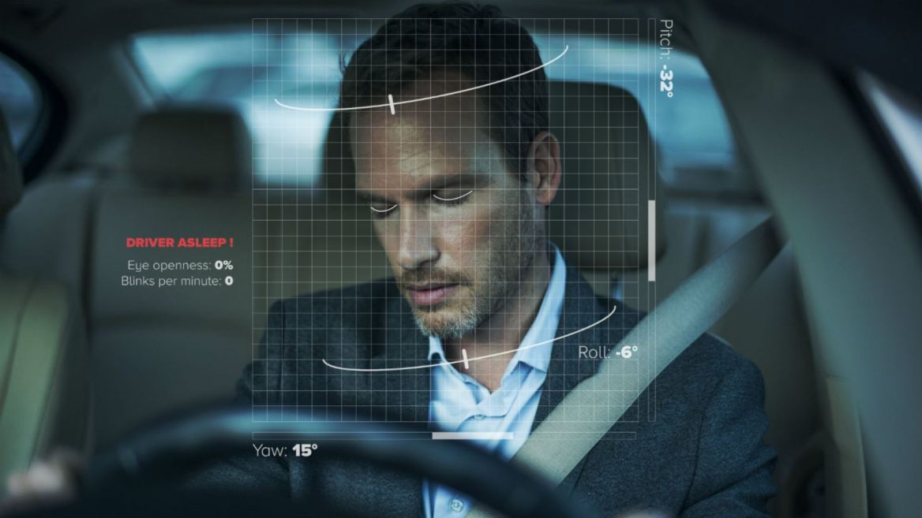
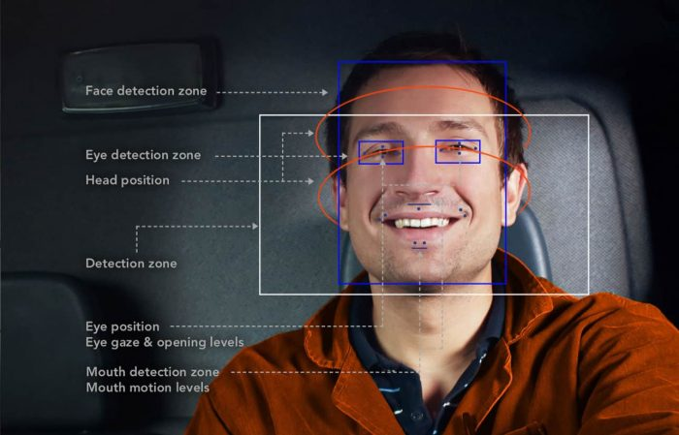

Slide 18
LOCALIZATION & TRACKING THE EYES
06

Slide 19
A raster scan algorithm is used for the exact location of the eyes and extracts that vertical location of eyes.
The eye is tracked by looking for the darkest pixel in the predicted region. In order to recover from tracking errors, it’s made sure that none of the geometrical constraints are violated. If they are, the eyes are re- localized to the next frame.
To find the best match for the eye template, it’s initially centered at the darkest pixel, and then a gradient descent is performed in order to find a local minimum.
The eyes is tracked by looking for the darkest pixel in the predicted region.

Slide 20
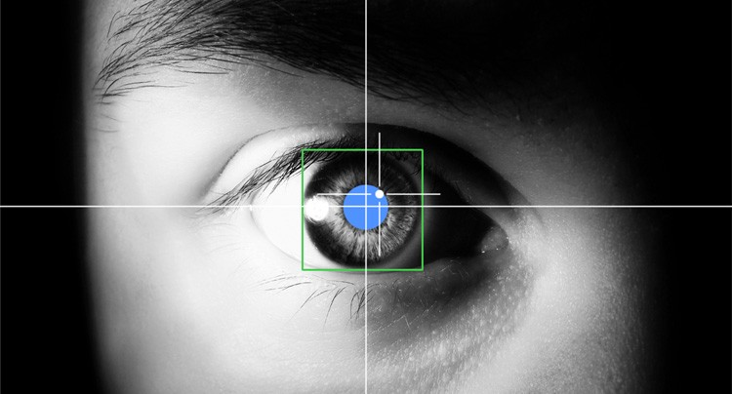
Detecting the Eyes

Slide 21
PRACTICAL SETUP
07

Slide 22
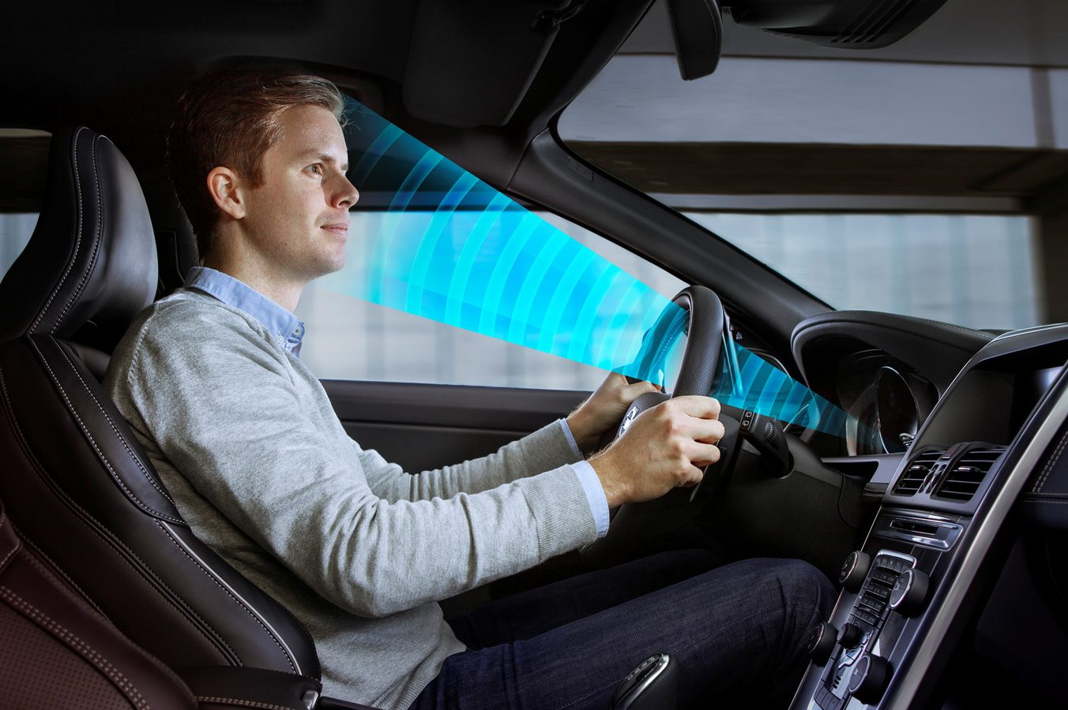

Slide 23
NEW IMAGE
Binarization
Remove Noise in Binary Image
Eye Detection Function
Face Top and Width Detection
Find Intensity Changes
Flowchart of the System:
Find Eye Position
Recognition of Whether Eyes are Open/ Closed
Calculation of Criteria for Judging Somniferous ness
Somniferousness
Detection
Function
Somniferous Driver?
Warning

Slide 24
DETECTION OF SOMNIFEROUS
08

Slide 25
As the driver becomes more fatigued, he/she is expected the eye-blinks to last longer. This lead to generation of consecutive frames which depict that the eyes are closed.
These frames are counted in order to decide the condition of the driver.
To determine whether the eyes are closed or open, a method is implemented that looks at the horizontal histogram across the pupil.

Slide 26
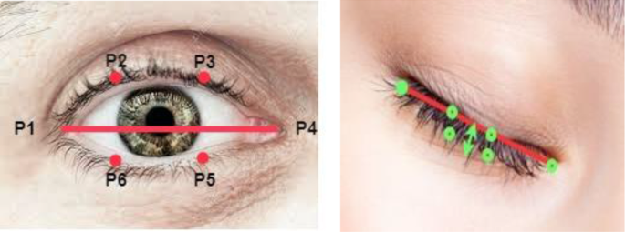
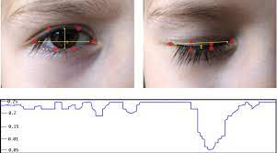

Slide 27
OUTCOMES
09

Slide 28
A number of leading automotive companies have implemented the DRIVER FATIGUE DETECTION SYSTEM which assist drivers in the physical and mental well being when behind the wheel.
Automobile companies like Volkswagen and Volvo have been the initial car developers to implement this system

Slide 29
VOLVO’S DRIVER ALERT SYSTEM
10

Slide 30
The Driver Alert System is a system that detects fatigued drivers and warns them before they fall asleep behind the wheel.
The Driver Alert System is intended to assist drivers
whose driving ability is deteriorating or who are inadvertently leaving the lane they are driving on.
Also to attract the driver's attention when he/she
starts to drive less consistently, e.g. if he/she becomes distracted or starts to fall asleep.
Driver Alert Control was the first fatigue detection
system developed by a car manufacturer, and has been on the market since 2007.

Slide 31
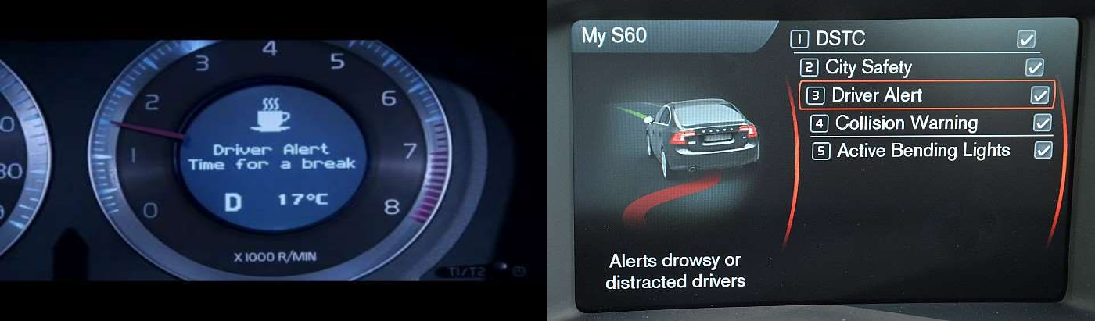

Slide 32
FUTURE SCOPE & CONSEQUENCES
11

Slide 33
The future is like we should install the whole system in the autonomous vehicle system so that it would be in the braking system if the driver in the system of the somniferous then it would apply brakes automatically and also lower the vehicle speed. And also park the vehicle alongside the road.

Slide 34
IMAGE OF PROJECT
12

Slide 35
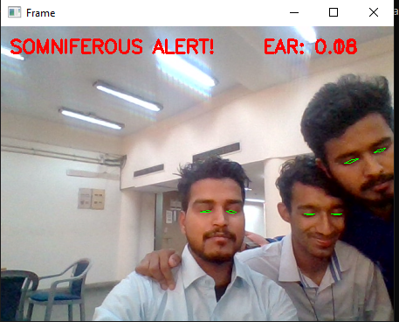
A PICTURE ALWAYS REINFORCES THE CONCEPT

Slide 36
SOURCE CODE OF THE PROJECT
13

Slide 37
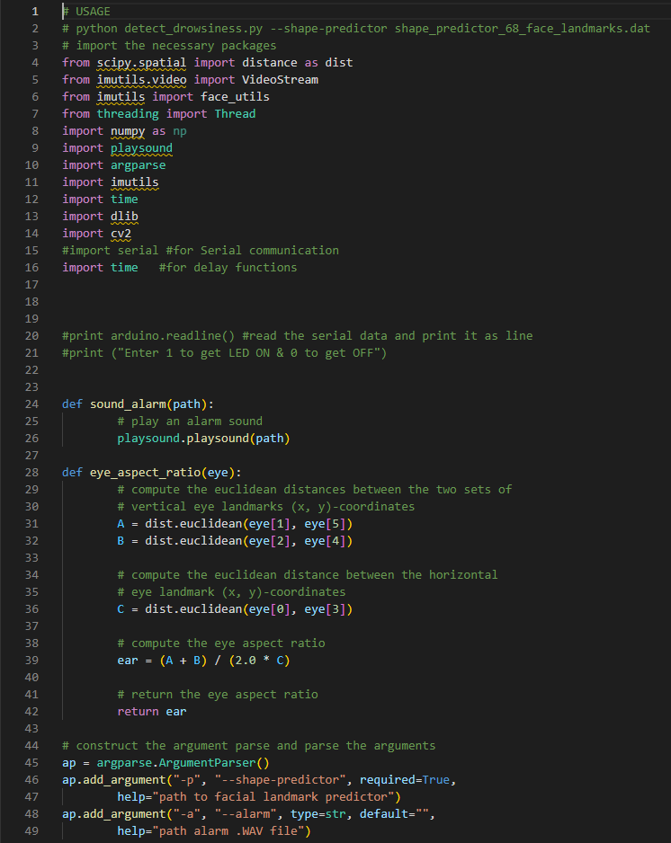

Slide 38
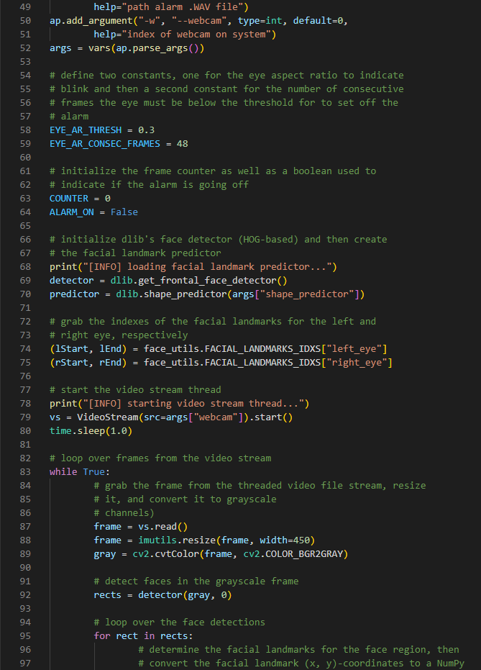

Slide 39
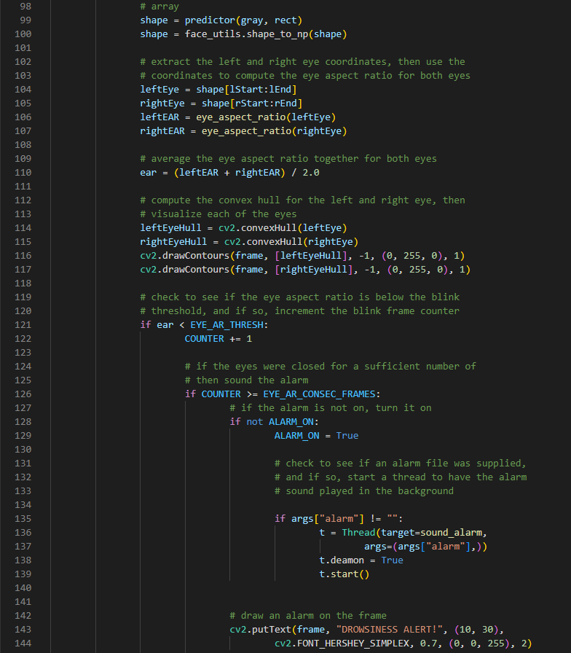

Slide 40
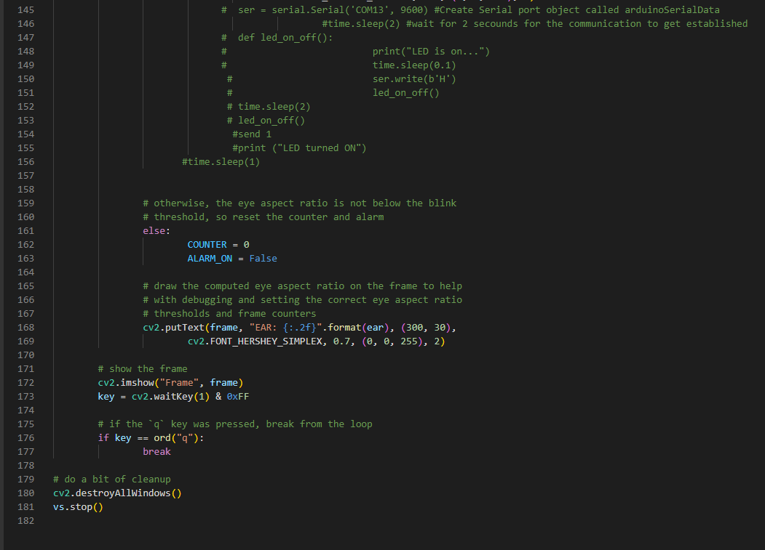

Slide 41
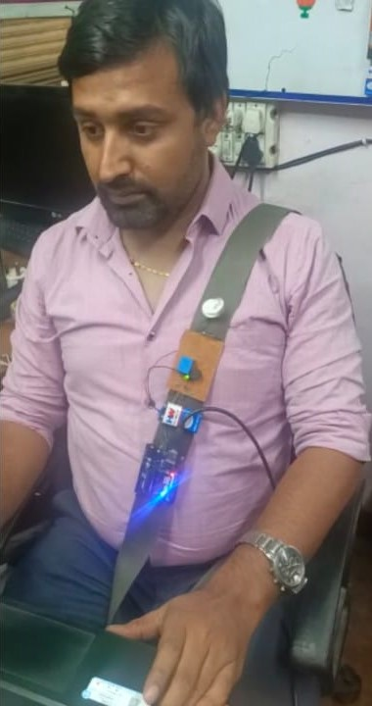
PROJECT IN PHYSICAL MODE

Slide 42
THANKS!

